Slide 1
Context
Christopher I. Macintosh, PhD, RN
Notes:
Hello everyone
My name is Chris Macintosh. I help teach the capstone courses.
Today we’re talking about describing the context of where your project is taking place.
[Next slide]

Slide 2
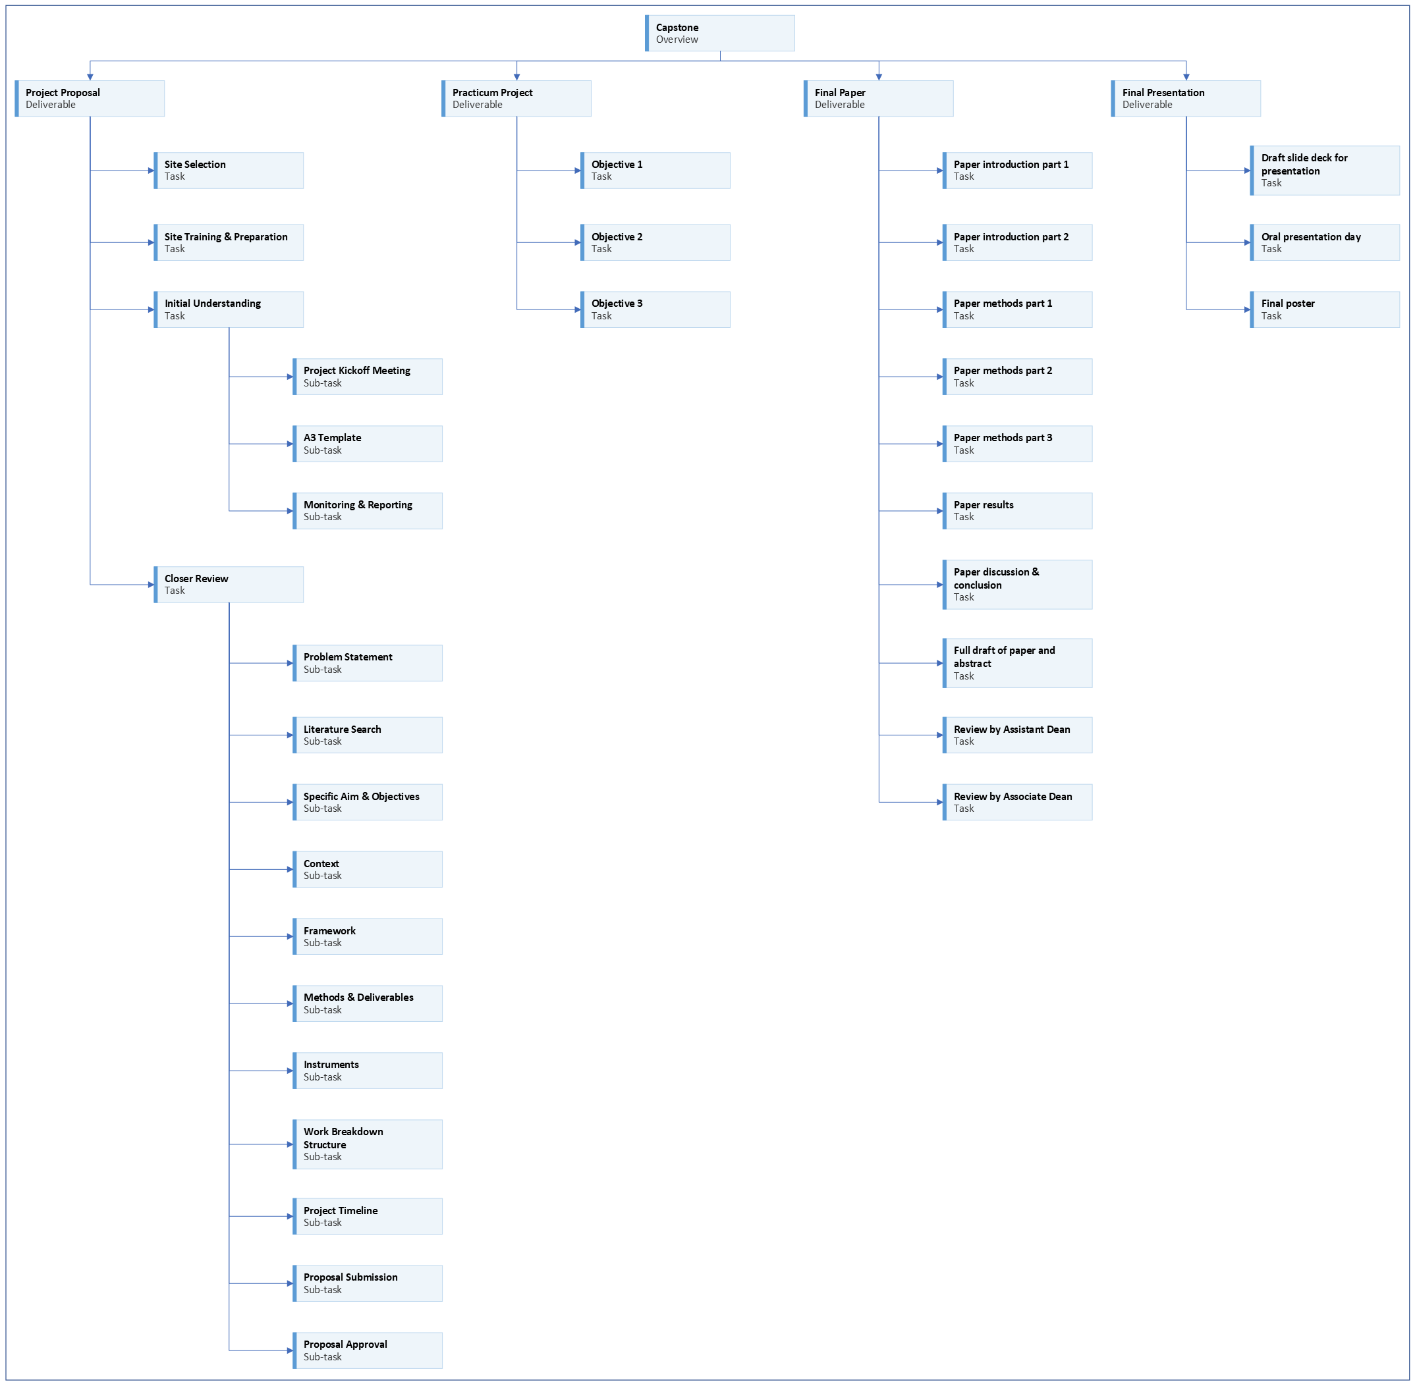
Notes:
[click]
We are working on the project proposal portion of your capstone experience.
[Next slide]

Slide 3
Notes:
Last time we talked about defining a specific aim and objectives.
[Next slide]

Slide 4
Notes:
Today we’re going to talk about describing the context of your project.
[Next slide]

Slide 5

Address feedback
Notes:
You should be addressing any feedback on your assignments and pasting updated content in the appropriate sections.
[next slide]

Slide 6





available knowledge
Notes:
If you haven’t finished, you should continue working on the Available Knowledge section.
[next slide]

Slide 7








Notes:
Before we go any further in outlining your project, it would be good to describe the setting and current condition of where your project is being conducted.
This is the context.
[click]
What do current conditions look like?
[click]
What is the setting where your project is taking place?
[click]
What is the patient population, staffing, system affiliation?
Who are the sponsors, team members, and beneficiaries of your project?
Describe who will directly and indirectly be impacted by your project.
You don’t need to name specific individuals, but you can refer to people by their roles and titles.
[click]
You could describe the process currently in place before you started your project.
[click]
You might consider creating a diagram or flow chart.
[click]
Is your capstone project part of a larger project?
If so, describe how it fits in with the larger project or meets the goals of the organization.
[click]
Describe any contextual factors that may impact the success of your project.
[next slide]

Slide 8
Ethical considerations
Ethical considerations relevant to project?
Ethical review process?
Conflicts of interest?
Find an article related to ethics in QI
Notes:
Quality improvement projects should follow standard ethical practices in healthcare.
[click]
Are there any ethical considerations relevant to your project?
What are they?
[click]
What kind of ethical review process is used for quality improvement at your location?
[click]
Do you have any conflicts of interest?
[click]
Find an article related to ethical considerations in quality improvement relevant to your project.
[next slide]

Slide 9

assignment
Notes:
[click]
Your assignment is to write about the contextual factors of your project mentioned in the previous slide.
[click]
Use proper APA citations and references where appropriate.
Be sure to cite and add your article about ethics in quality improvement to your reference list.
[click]
Include any tables or figures after the References section.
[next slide]

Slide 10

More to come . . .
Notes:
That’s all we’ll do in this video.
There is more to come.
[next slide]

